Slide 1

Effect of a treatment using causal inference
Teresa Alves de Sousa – Rayan Charrier – Sofiane Hadji – Randy Kotti – Ilyas Malik
December, Tuesday 11th

Slide 2
Introduction
Traumabase
Data : from 7000 patients, 250 variables to 3000 patients, 35 variables
Goal : perform causal inference to assess the effect of a treatment on the mortality of patients with head trauma

Slide 3
Introduction
Patients : Trauma.cranien == 1 || AIS.tete ≥ 2
Treatment : Acide Tranexamique
Outcome : DC.Trauma / Glasgow.sortie

Slide 4
Summary
Preprocessing
Missing values analysis
Imputation
Restriction
Descriptive analysis
Principal component analysis
Hierarchical clustering
Visualization of main variables
Causal inference
Matching
Inverse Propensity Weighting
Discussion

Slide 5

I. Preprocessing

Slide 6
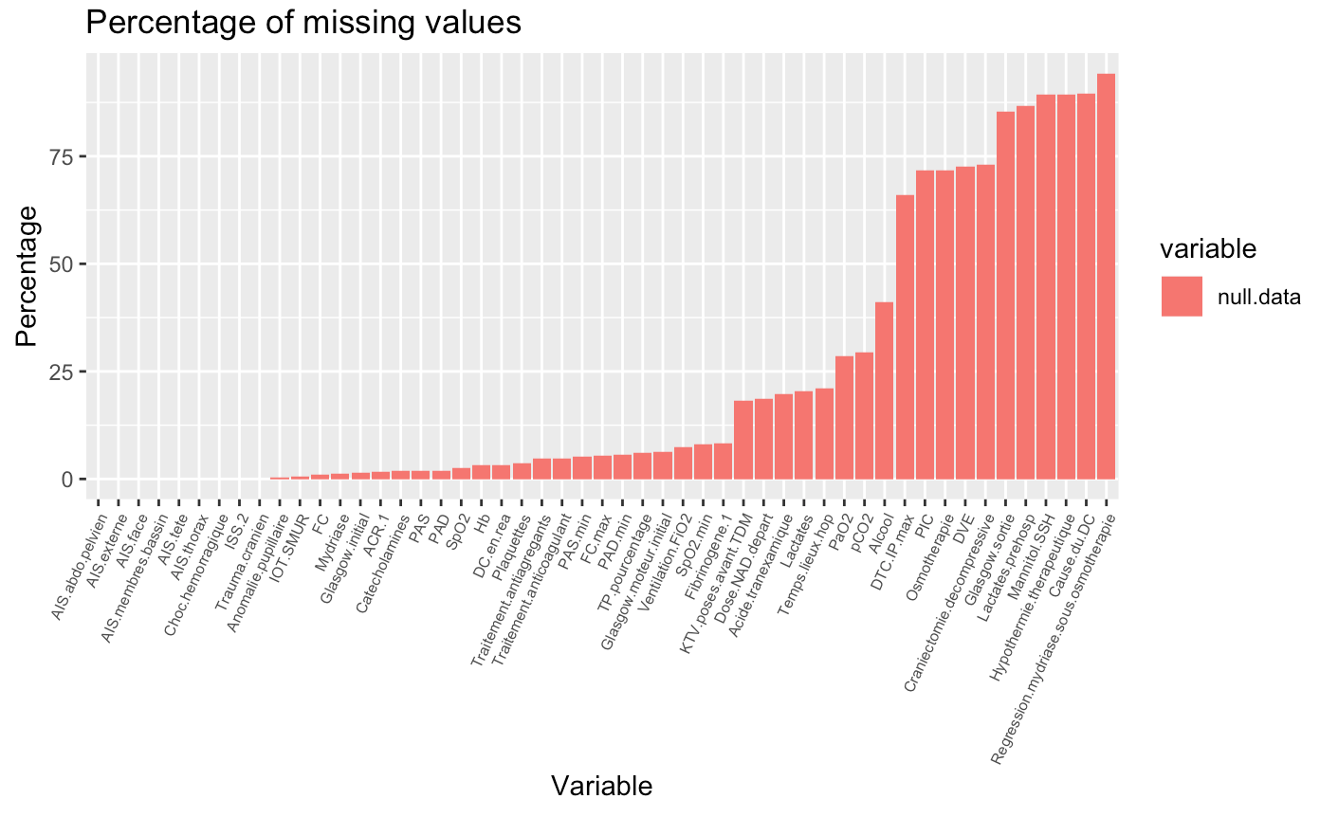
Preprocessing
Missing values analysis
From 244 variables, we keep 54 based on the doctors’ input.
Many of these null entries are not really missing – distinguishing them implies understanding the medical guidelines.

Slide 7
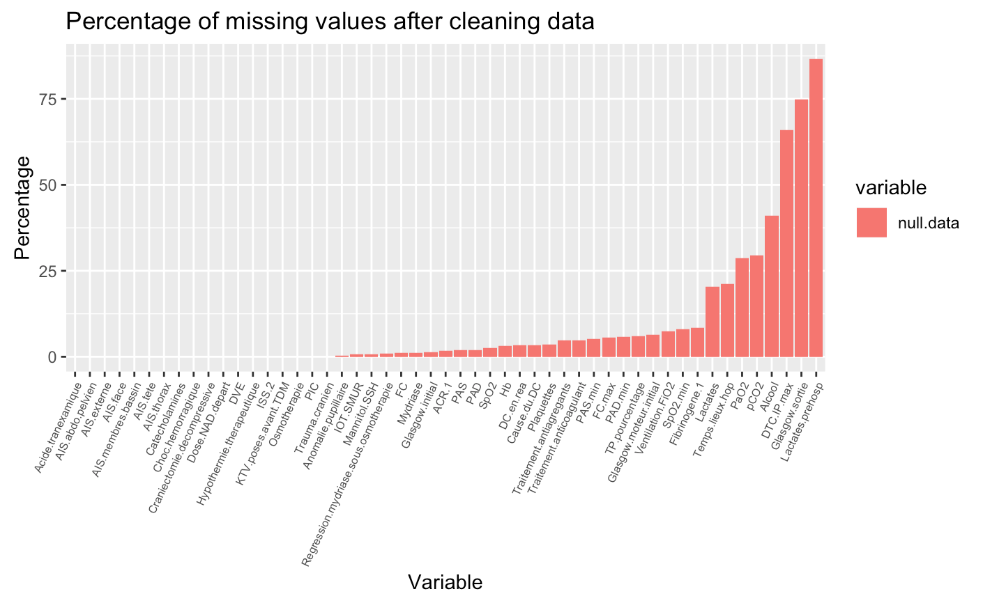
Preprocessing
Missing values analysis – not really missing entries
We delete the only variable that has more than 75% of missing data: Lactates.prehosp
Only 3 remaining variables that have more than 26% of missing values: Alcool, DTC.IP.max and Glasgow.sortie

Slide 8
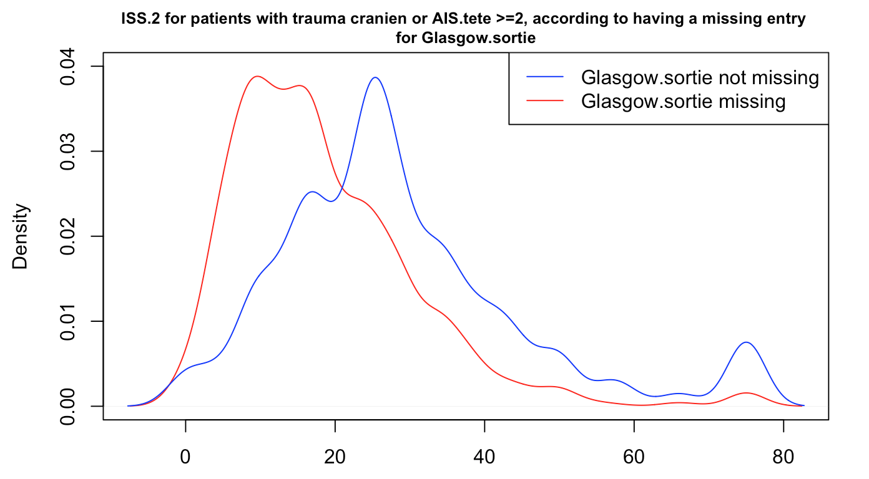
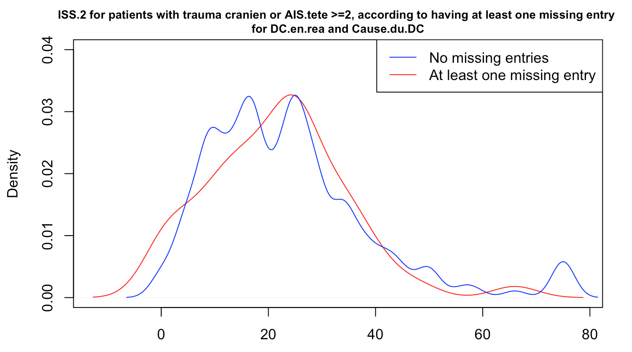
Preprocessing
Missing values analysis – missing completely at random?

Slide 9
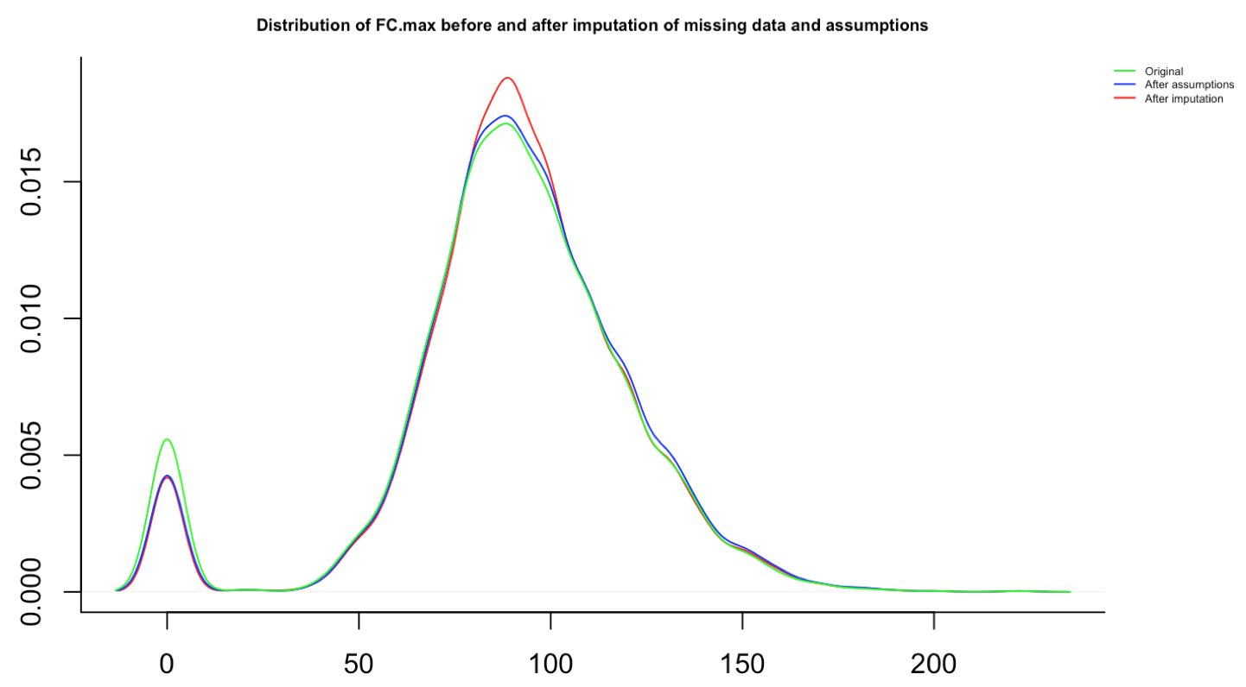
Preprocessing
Imputation
Main method: iterative Factorial Analysis for Mixed Data model, package missMDA
Most distributions unchanged - MCAR

Slide 10
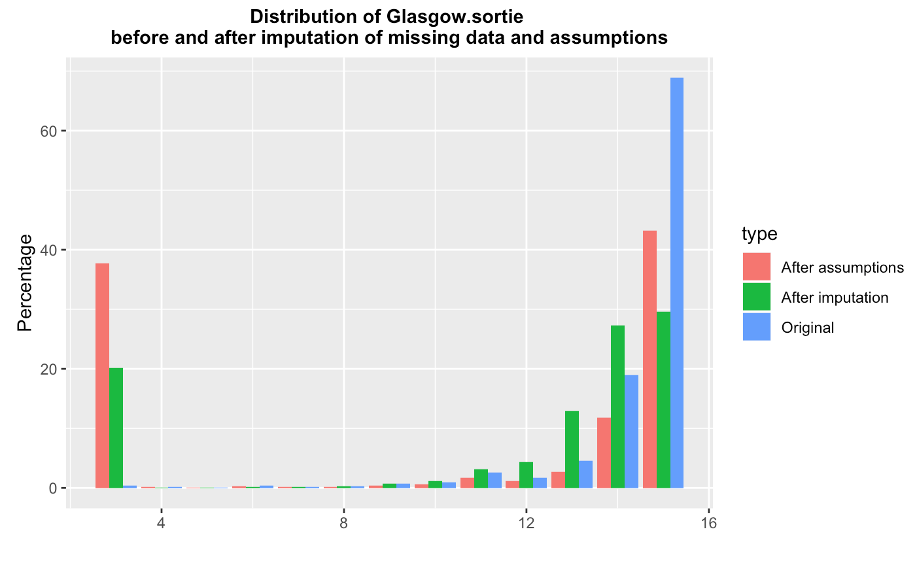
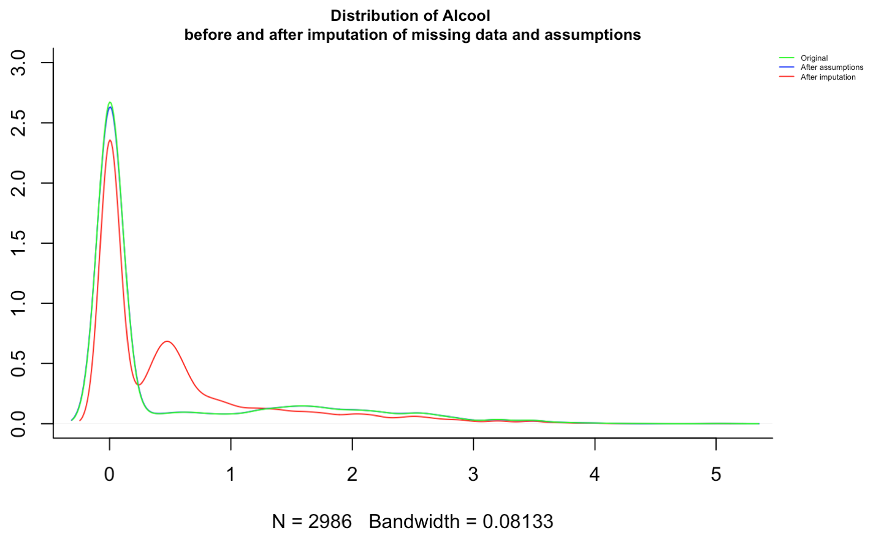
Preprocessing
Imputation
But some source of concern with Glasgow.sortie, Alcool
Alternative method run to test sensitivity of causal inference to imputation: random forest, package missForest

Slide 11
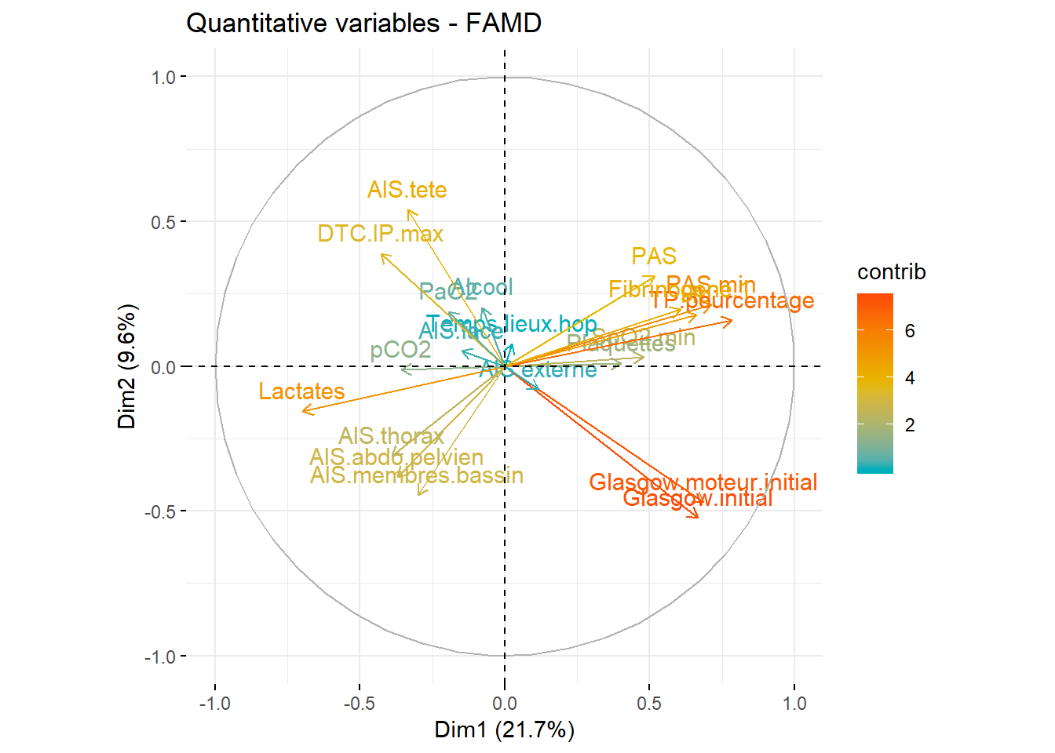
II. Descriptive analysis

Slide 12
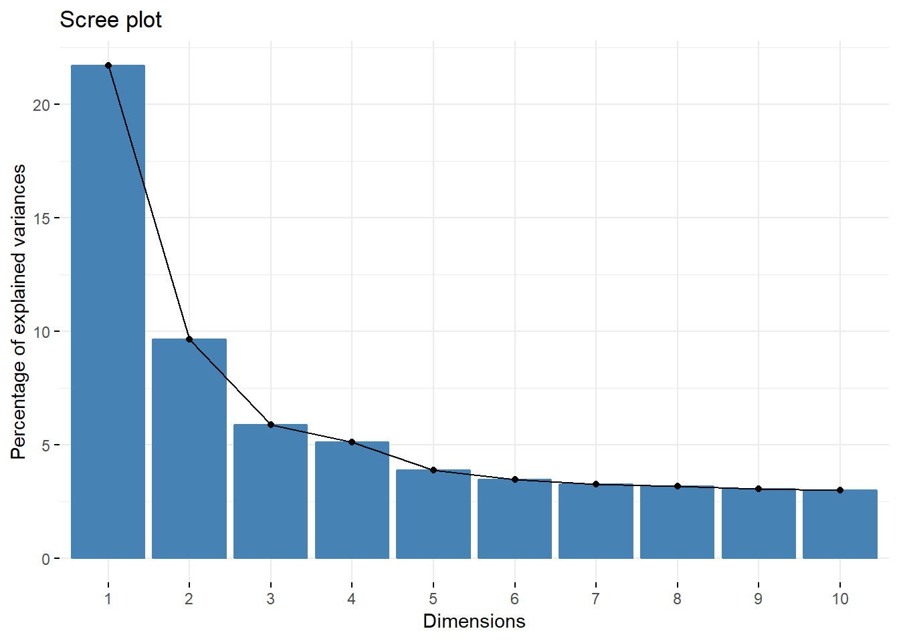
Descriptive analysis
Factorial analysis of mixed data
Extracting most of the information using only 10 components
62% of the variance kept
Working on quantitative variables

Slide 13
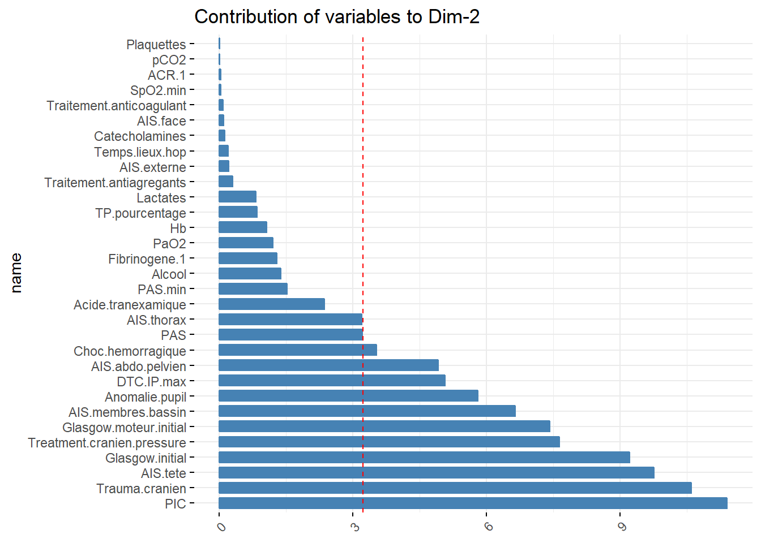
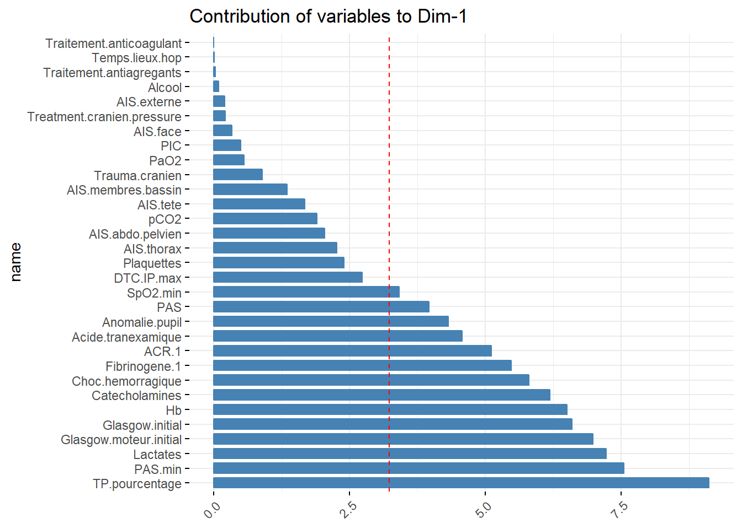
Descriptive analysis
Factorial analysis of mixed data

Slide 14
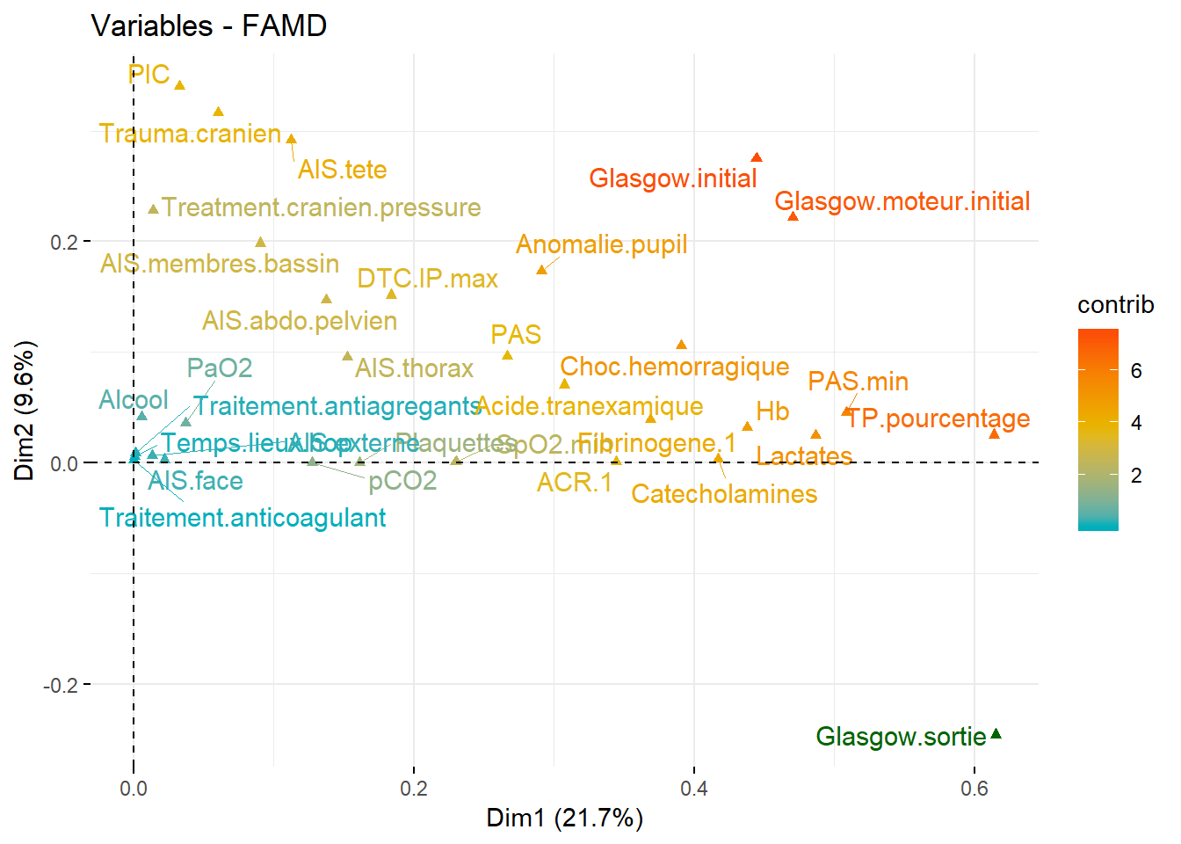
Descriptive analysis
Factorial analysis of mixed data
Visualizing the contribution of each variable to the principal components
Gives an idea on the correlation between variables

Slide 15

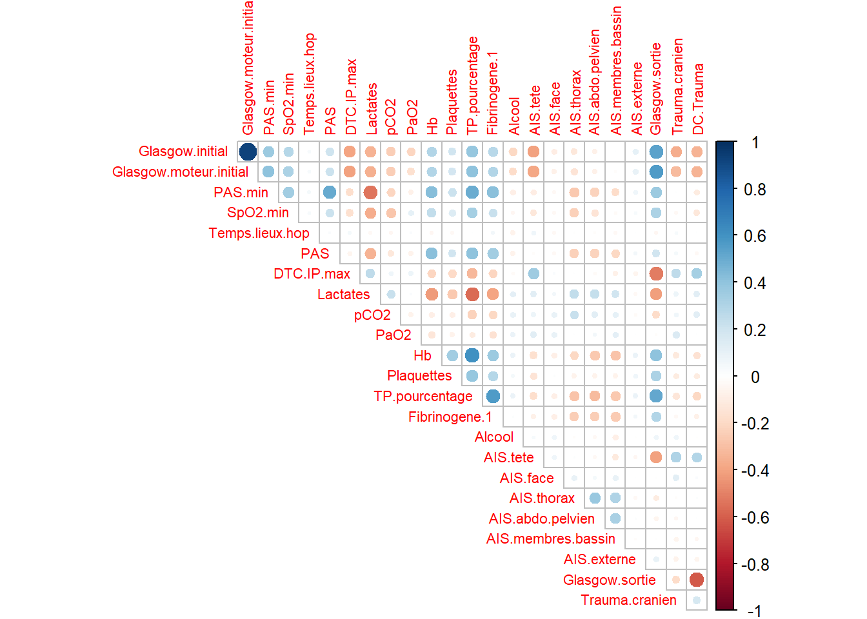
Descriptive analysis
Factorial analysis of mixed data
Extracting most of the information using only 10 components
62% of the variance kept
Working on quantitative variables

Slide 16
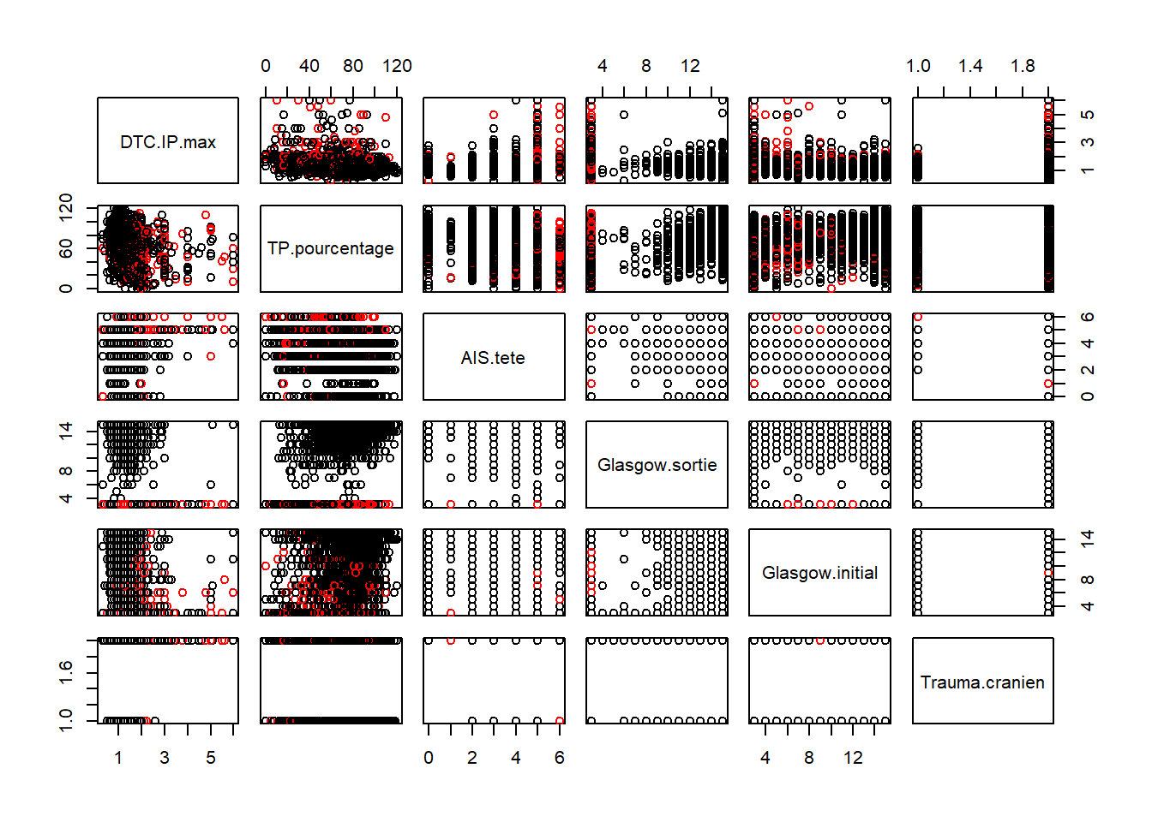
Descriptive analysis
Factorial analysis of mixed data

Slide 17
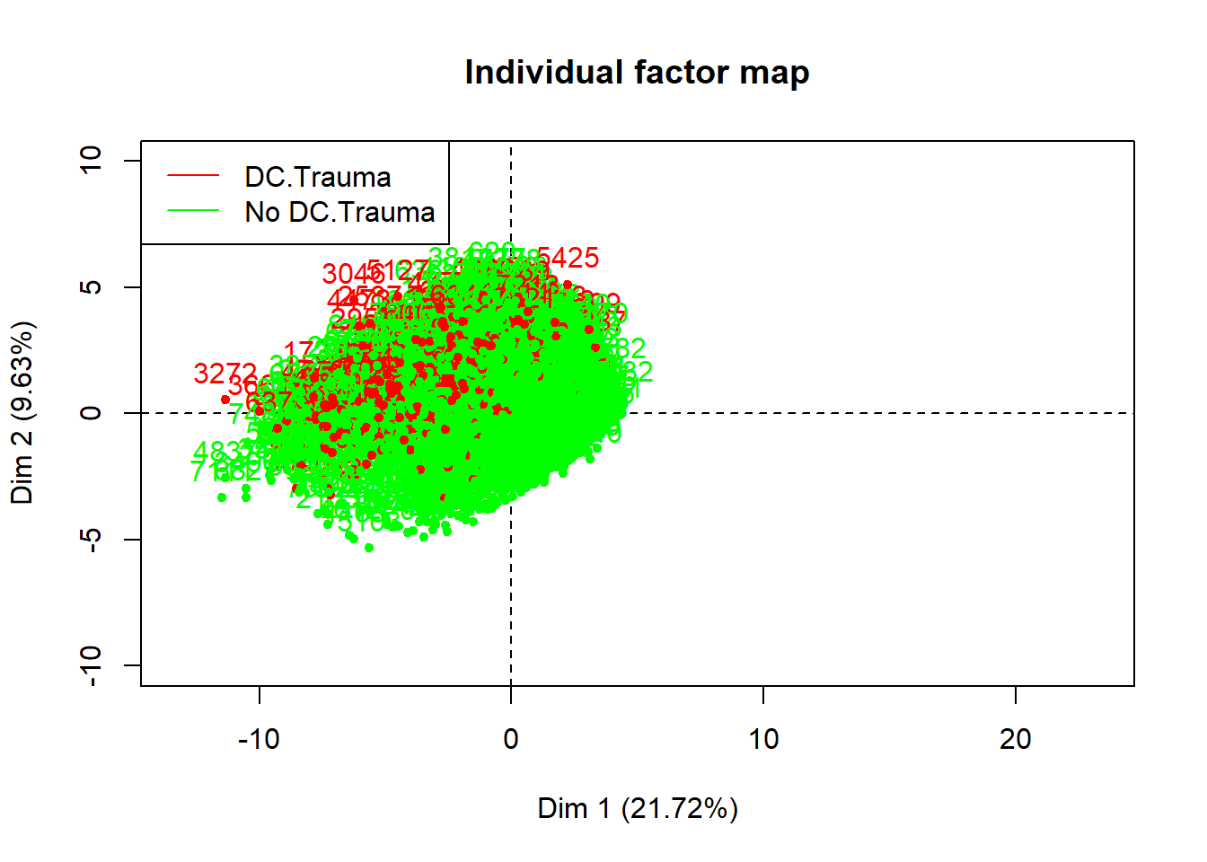
Descriptive analysis
Hierarchical clustering
Cluster patients to understand the link between DC.Trauma and variables
Both categorical and quantitative variables: clustering using FAMD
R package: Hierarchical Clustering on Principal Components

Slide 18
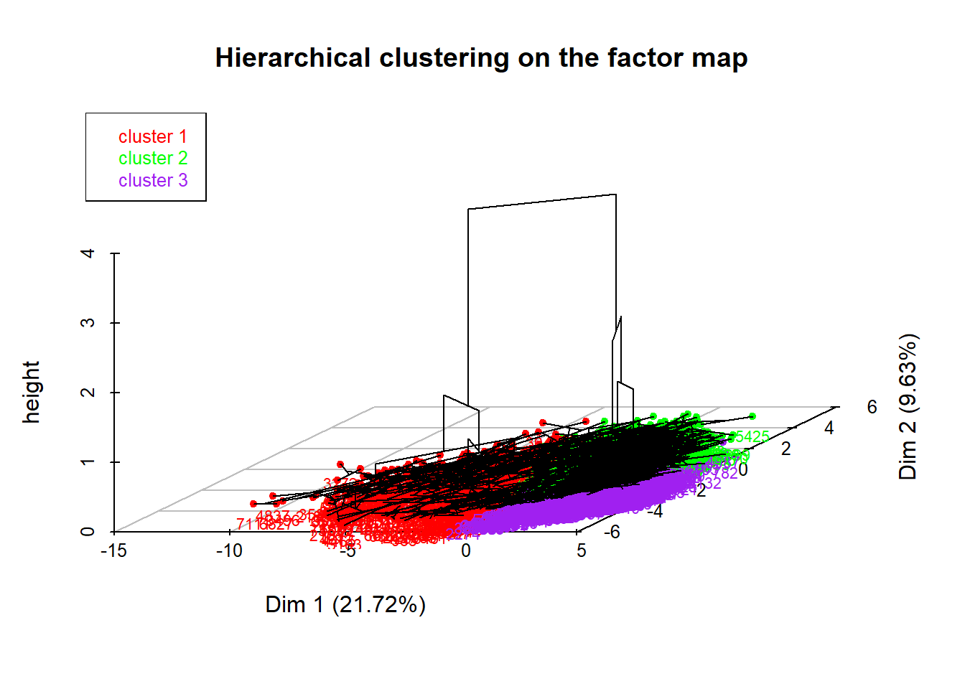
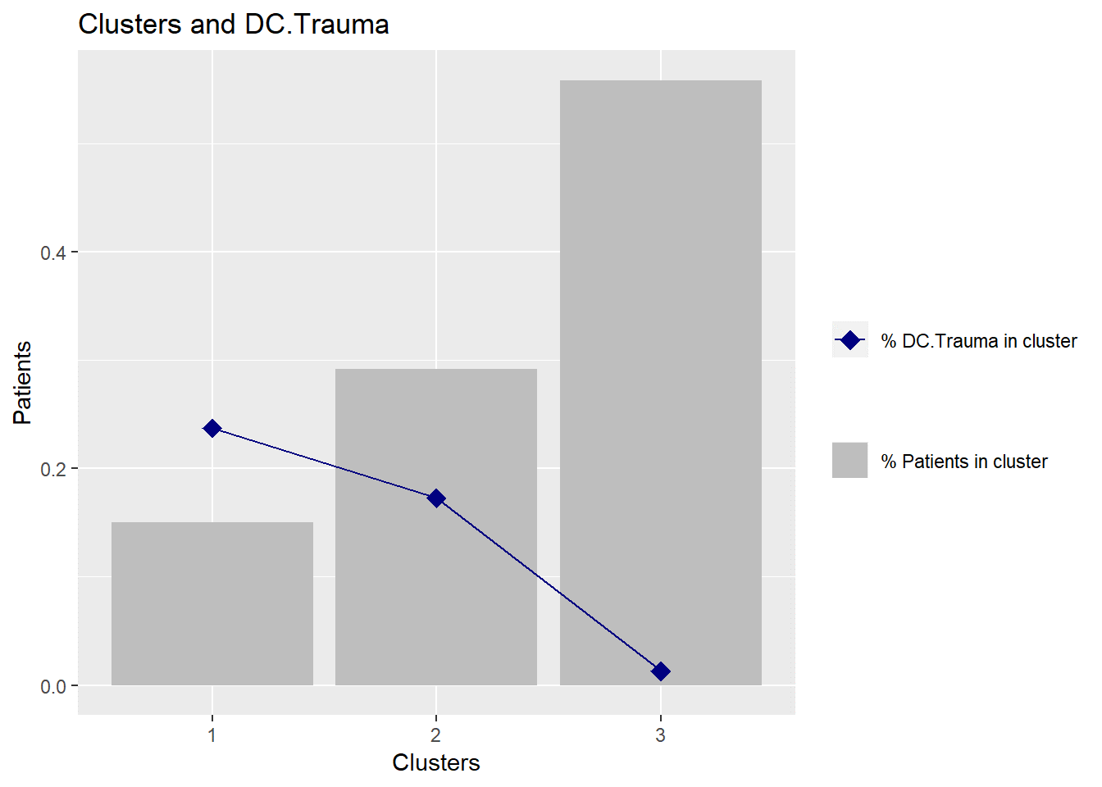
Descriptive analysis
Hierarchical clustering
Hierarchical clustering output

Slide 19
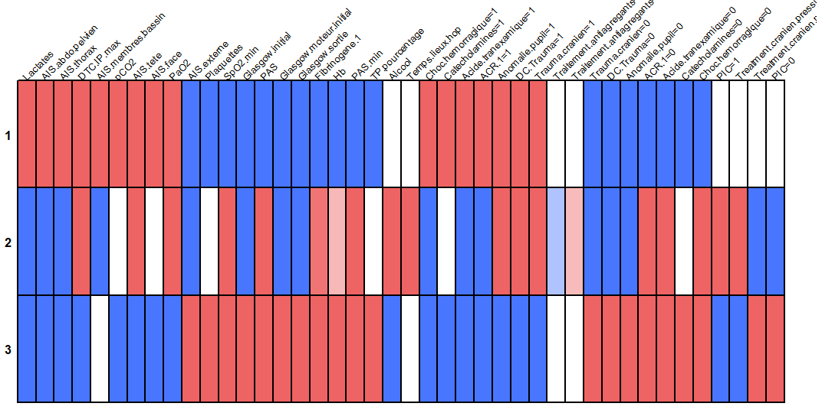
Descriptive analysis
Hierarchical clustering
High
Increasing mortality
Low
Notes:
Most endangered patients have:
Low
Glasgow
Hb
TP.Pourcentage
Fibrinogene
Plaquettes
High
Lactates
Anomalie pupillaires
DTC
AIS
pCO2 / PaO2
The difference between groups 2 and 3 mainly relies on PAS, AIS.externe, and Lactates.

Slide 20
Descriptive analysis
Data visualization
Idea : Doctors look at measurements of variables to take their decisions
Goal : Check their assumptions and possibly find new ways to predict trauma/shock/necessity of using Acide.tranexamique
Notes:
Doctors measure some variables before the hospital and during the hospital, to help them decide the gravity of the state of the patients.
We studied the variables which had the most influence on the 1st dimension of the FAMD (and which are the most important)
Glasgow.moteur.initial,Glasgow.initial (before hospital)
Glasgow.moteur,, Hb, Tp.pourcentage(during hospital)
Anticipate whether there was trauma

Slide 21
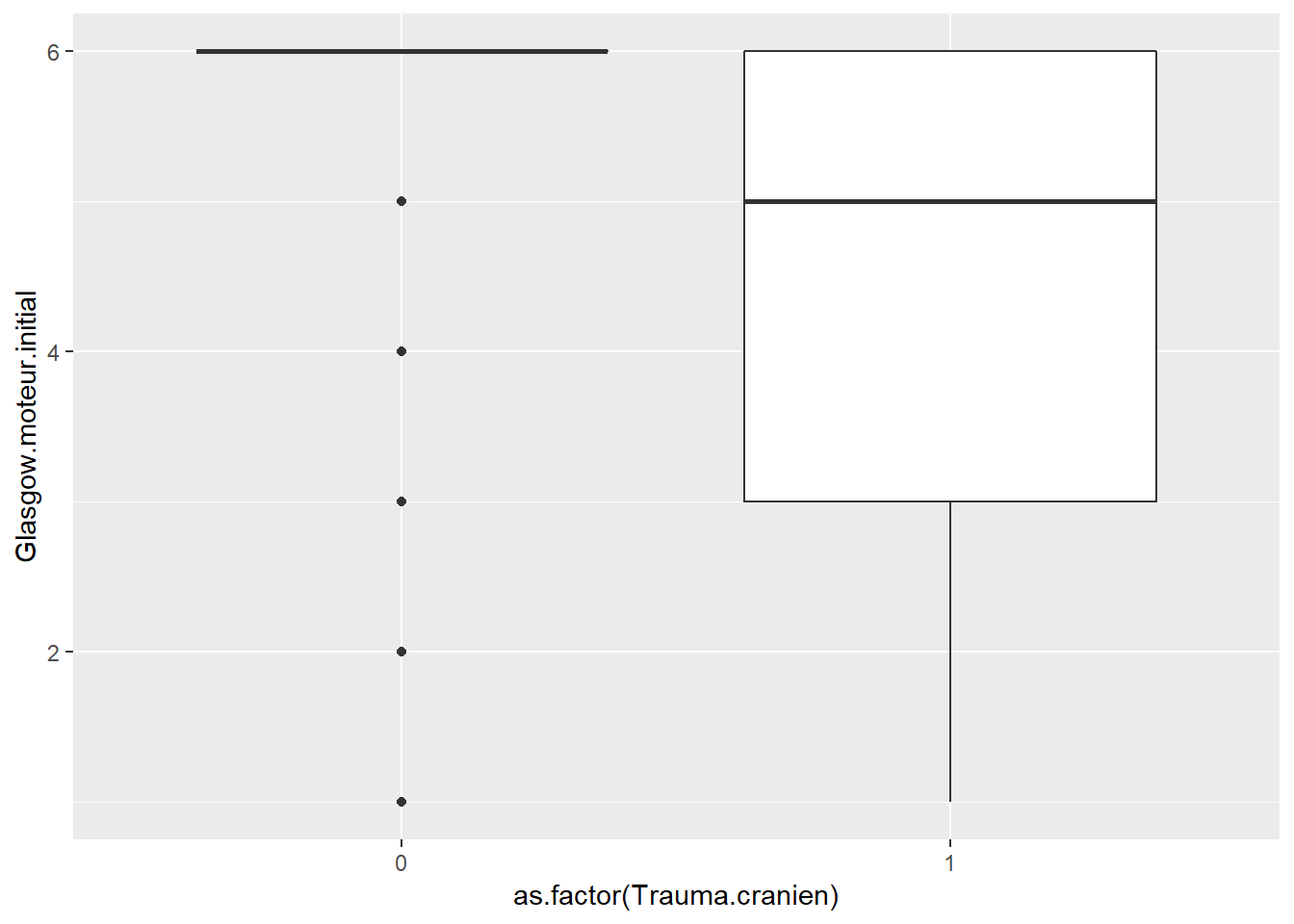
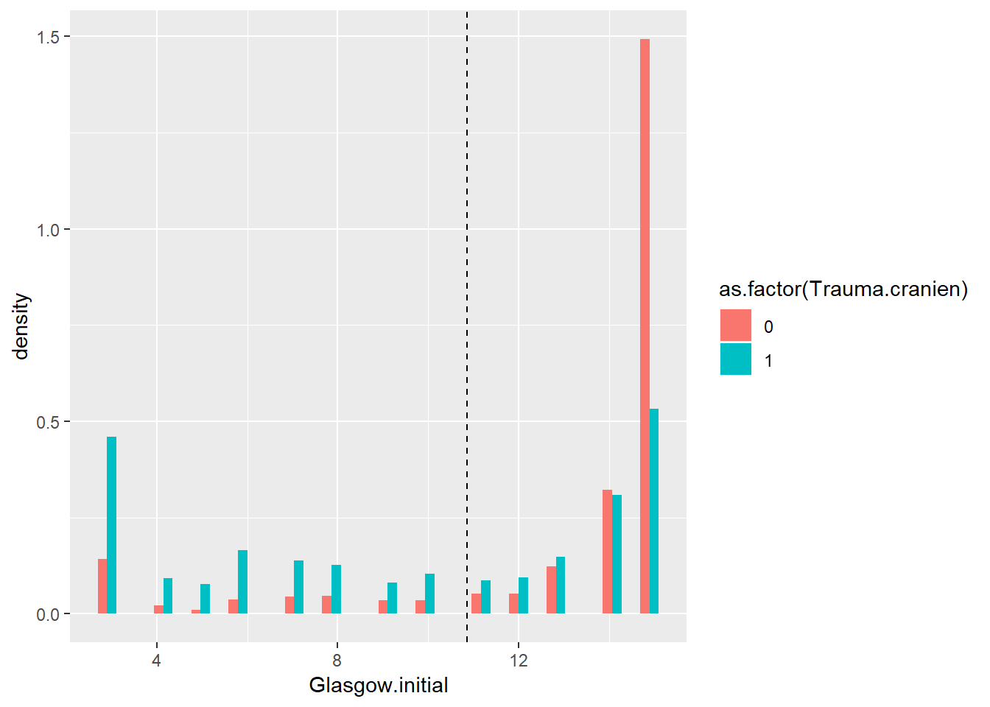
Descriptive analysis
Data visualization
Glasgow.initial and Cranial trauma
Notes:
Glasgow.initial and glasgow.moteur.initial : supposed to be good indicators of cranian.trauma
But, not really of hemorragique schock
People without trauma have very high Glagow.initial scores
People with trauma have a wide range of scores
Cl : Glasgow.initial interesting when not maximal value

Slide 22
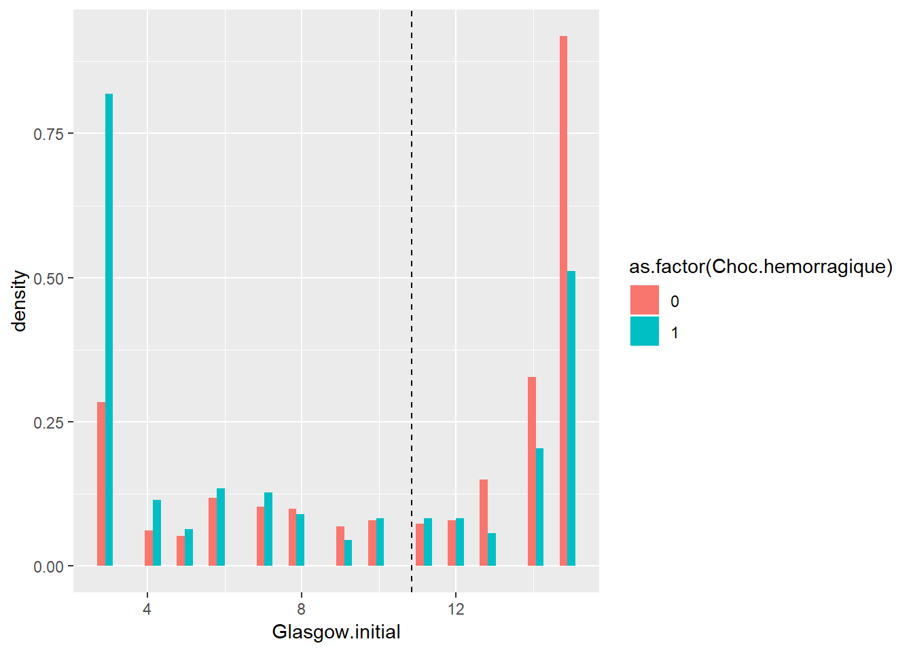
Descriptive analysis
Data visualization
Glasgow.initial and Hemorrhagic shock
Notes:
Hemoragic shock : difficult to say anything, you can have a good Glasgow score despite a shock.

Slide 23
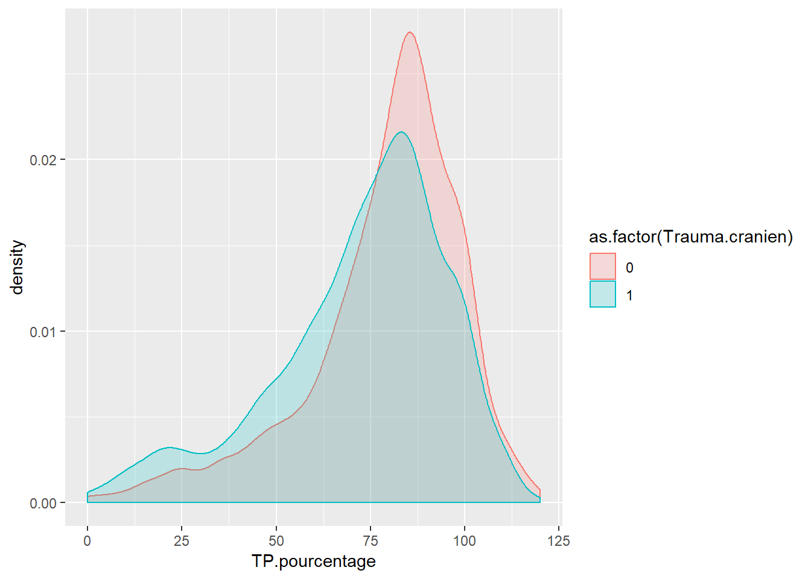
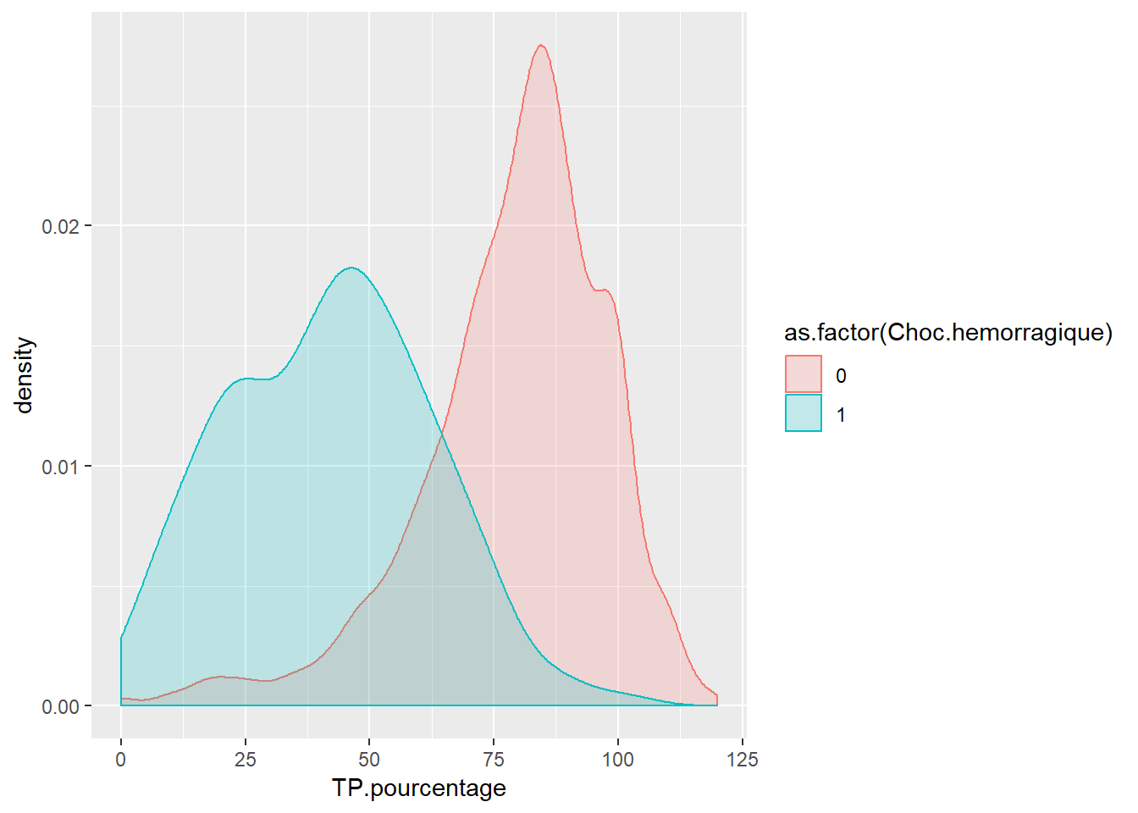
Descriptive analysis
Data visualization
Prothrombin Ratio
Cranial Trauma
Hemorrhagic shock
Notes:
TP.Pourcentage refers to the Prothrombin Ratio in blood. If the value is different from the mean, it is harder for the blood to coagulate, and there is a greater chance of hemorraghy in the brain.
We do notice it is significantly lower for patients who had a shock, which is coherent.

Slide 24
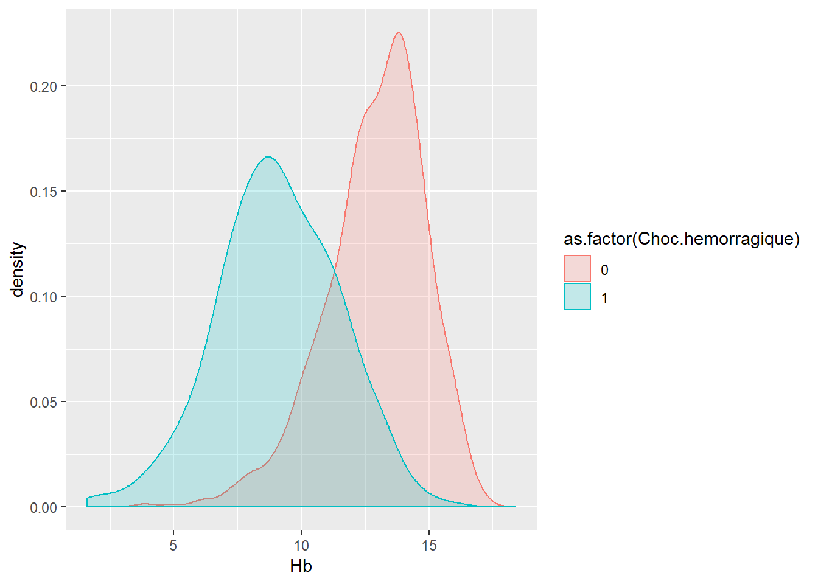
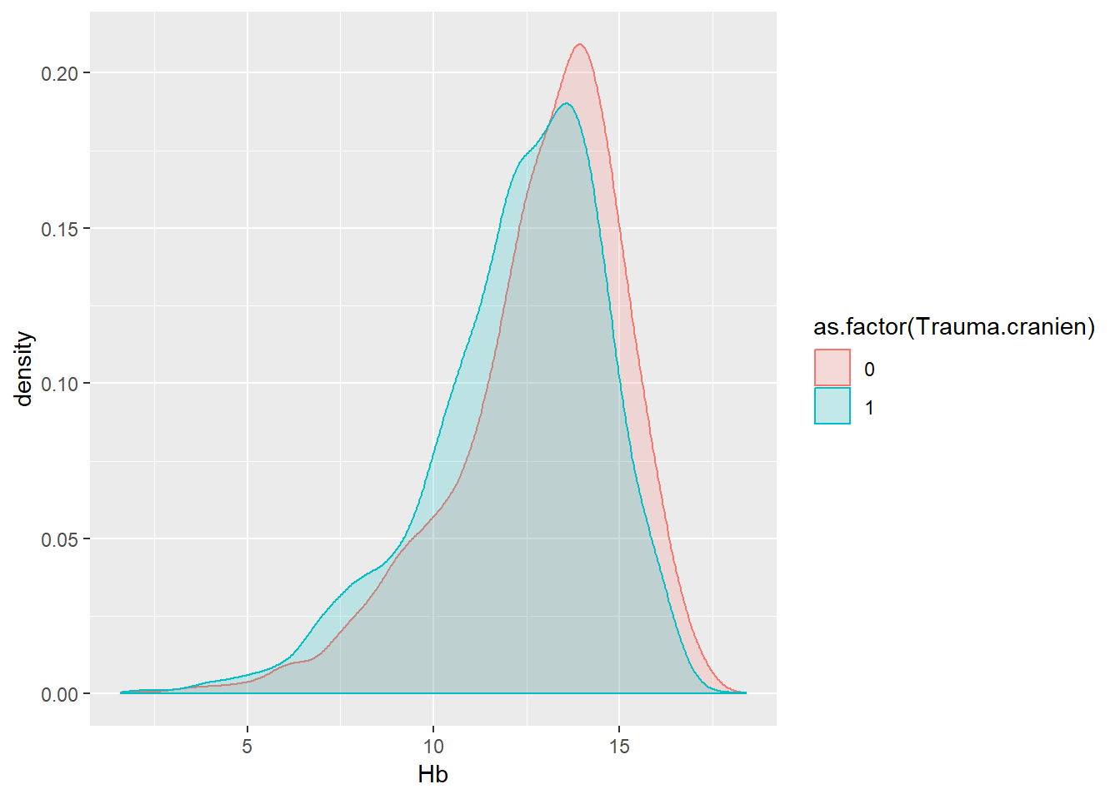
Descriptive analysis
Data visualization
Hb Percentage
Cranial Trauma
Hemorrhagic shock
Notes:
Same reasoning for Hb Pourcentage

Slide 25
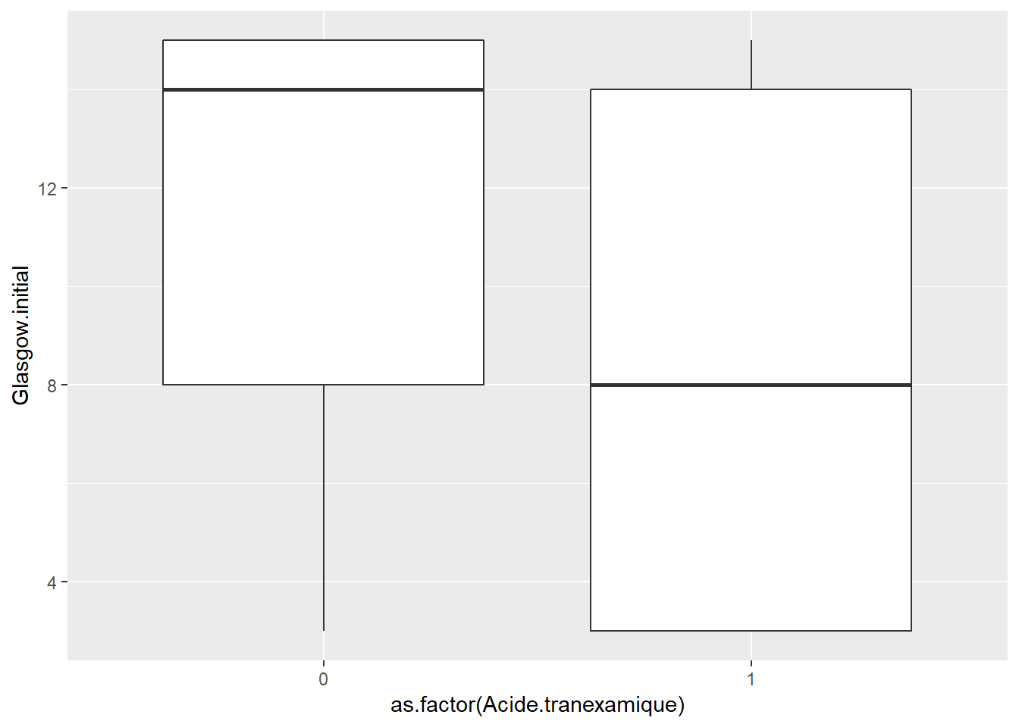
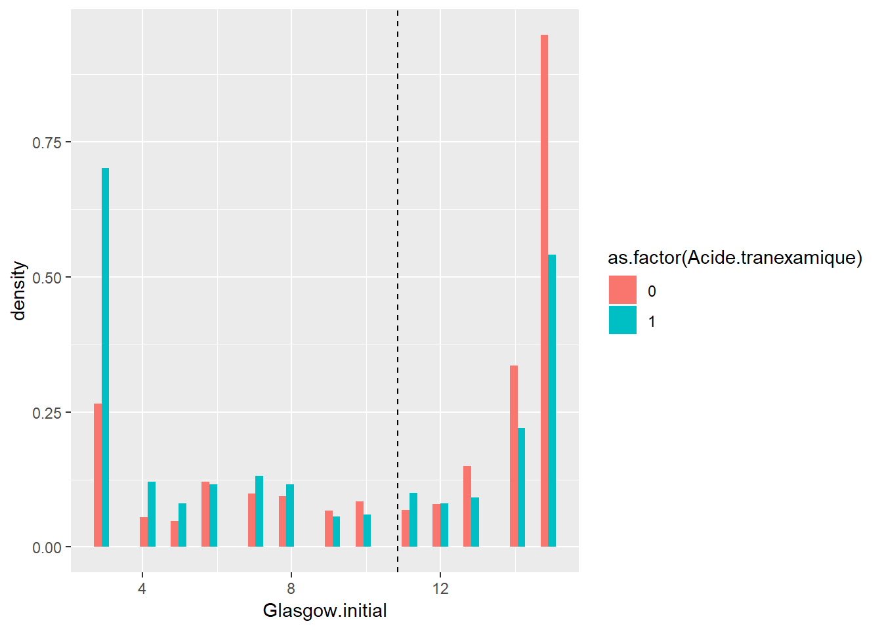
Descriptive analysis
Data visualization
Acide tranexamique
Notes:
Here, same issue with hemorragic shock. Acide tranexamique given in order to stop the shock, to Glasgow score is not a good indicator. If we want to predict, not a good indciator.
However, we can confirm that the patients who got treatment tended to have lower values of Glasgow

Slide 26
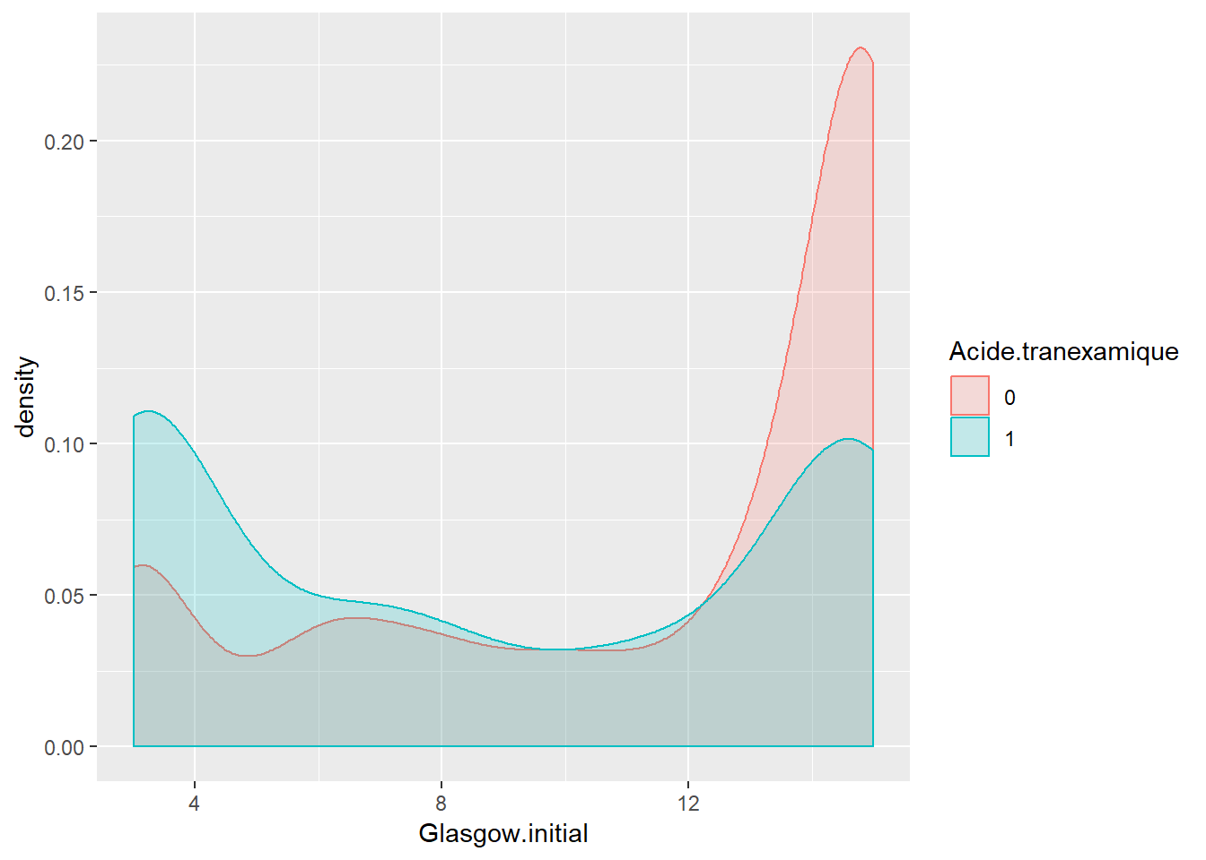
Descriptive analysis
Data visualization
Acide tranexamique
Notes:
Here, same issue with hemorragic shock. Acide tranexamique given in order to stop the shock, to Glasgow score is not a good indicator. If we want to predict, not a good indciator.
However, we can confirm that the patients who got treatment tended to have lower values of Glasgow. This suggests a bias we will have to correct

Slide 27
Descriptive analysis
Data visualization
P(Died| Treated) : 0.16
P(Died| Not treated) : 0.08
Treatment kills ?
Notes:
Here, same issue with hemorragic shock. Acide tranexamique given in order to stop the shock, to Glasgow score is not a good indicator. If we want to predict, not a good indicator.
However, we can confirm that the patients who got treatment tended to have lower values of Glasgow. This suggests a bias we will have to correct

Slide 28
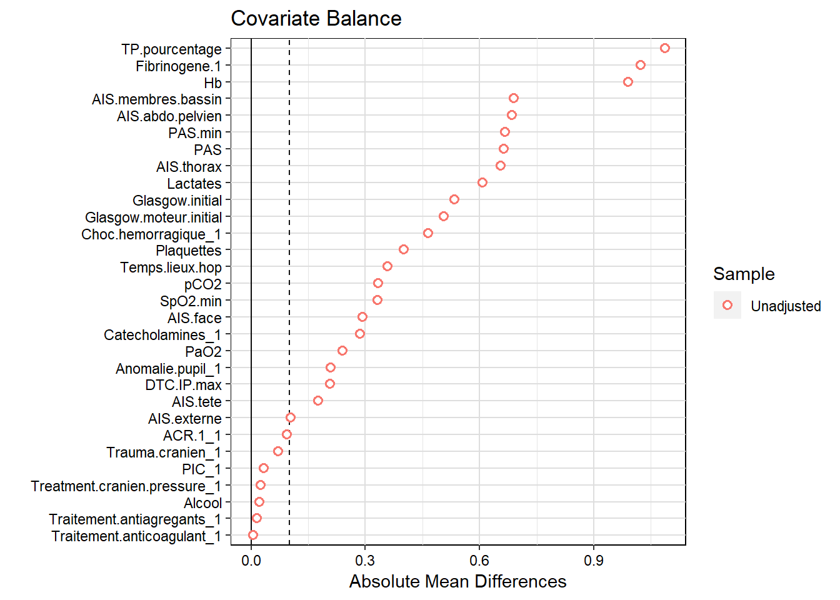
Descriptive analysis
Data visualization
Comparaison of the treated/nontreated patients
Notes:
We compare the absolute mean differences(between the two groups. Empirically, SMDs higher than 0.1 demonstrate difference between the two groups.
A lot of variables are have such SMDS, especiallt TP.pourcentage and Hb(already seen before)
Consequently, there is a need for causal inference, as

Slide 29
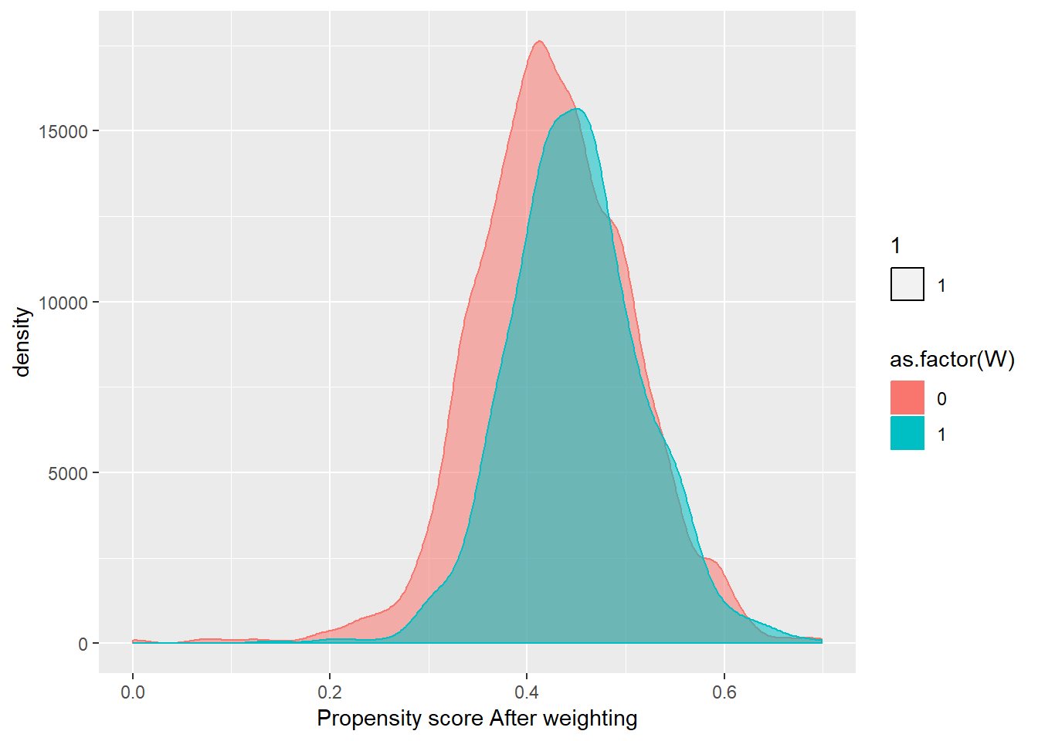
III. Causal Inference

Slide 30

Causal Inference
Matching
Pair each treated patient with a similar untreated patient
R package: Matching
Then, regression: DC.Trauma ~ Acide.tranexamique

Slide 31
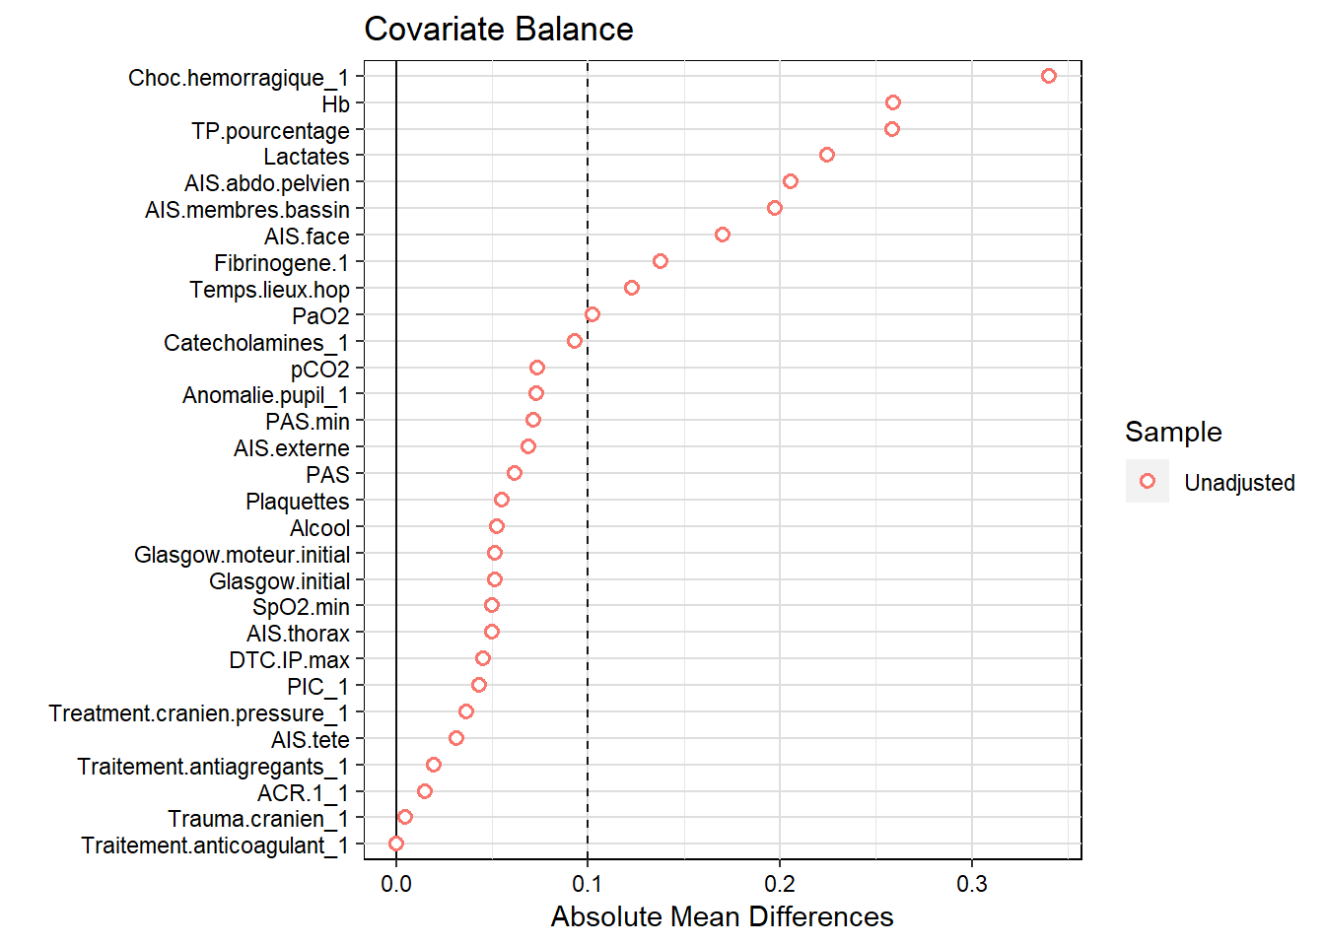
Causal Inference
Matching
Before matching
After matching

Slide 32
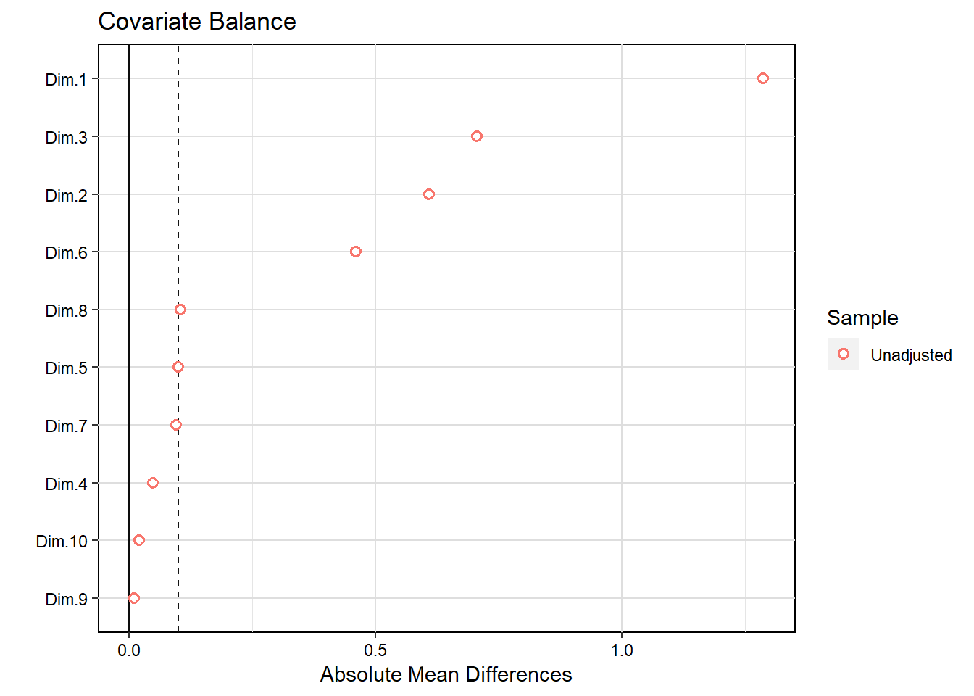
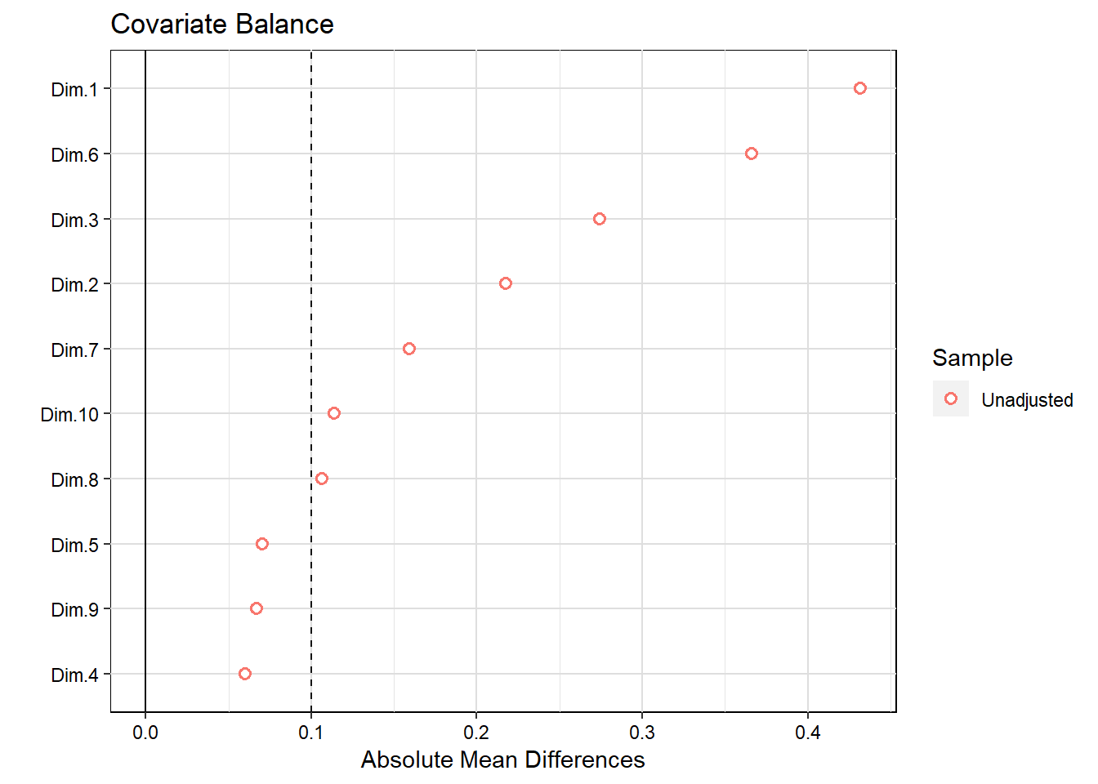
Causal Inference
Matching
Before matching
After matching

Slide 33
Causal Inference
Inverse Propensity Weighting
Correct the effect of confounding factors
R package: ipw, survey, grf
IPW estimator of IPW, double-robust estimator, linear regression

Slide 34
Causal Inference
Matching
Average treatment effect using Matching

Slide 35
Causal Inference
Inverse Propensity Weighting
Weighting
Bad condition
Good condition

Slide 36
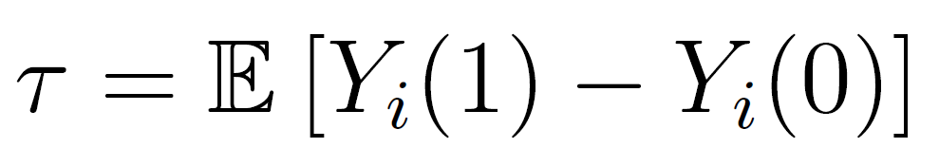
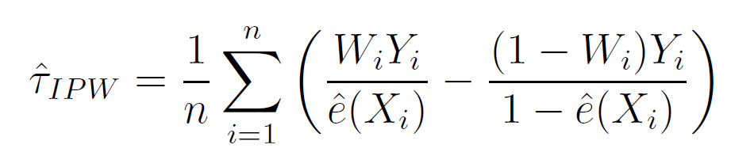
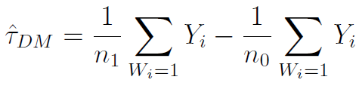
Causal Inference
Inverse Propensity Weighting
Notes:
Présenter Y et W
W indé de {Y(1), Y(0)}

Slide 37
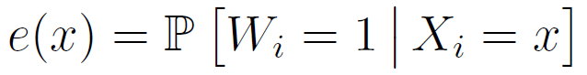
Causal Inference
Inverse Propensity Weighting
Notes:
Présenter Y et W
W indé de {Y(1), Y(0)}

Slide 38
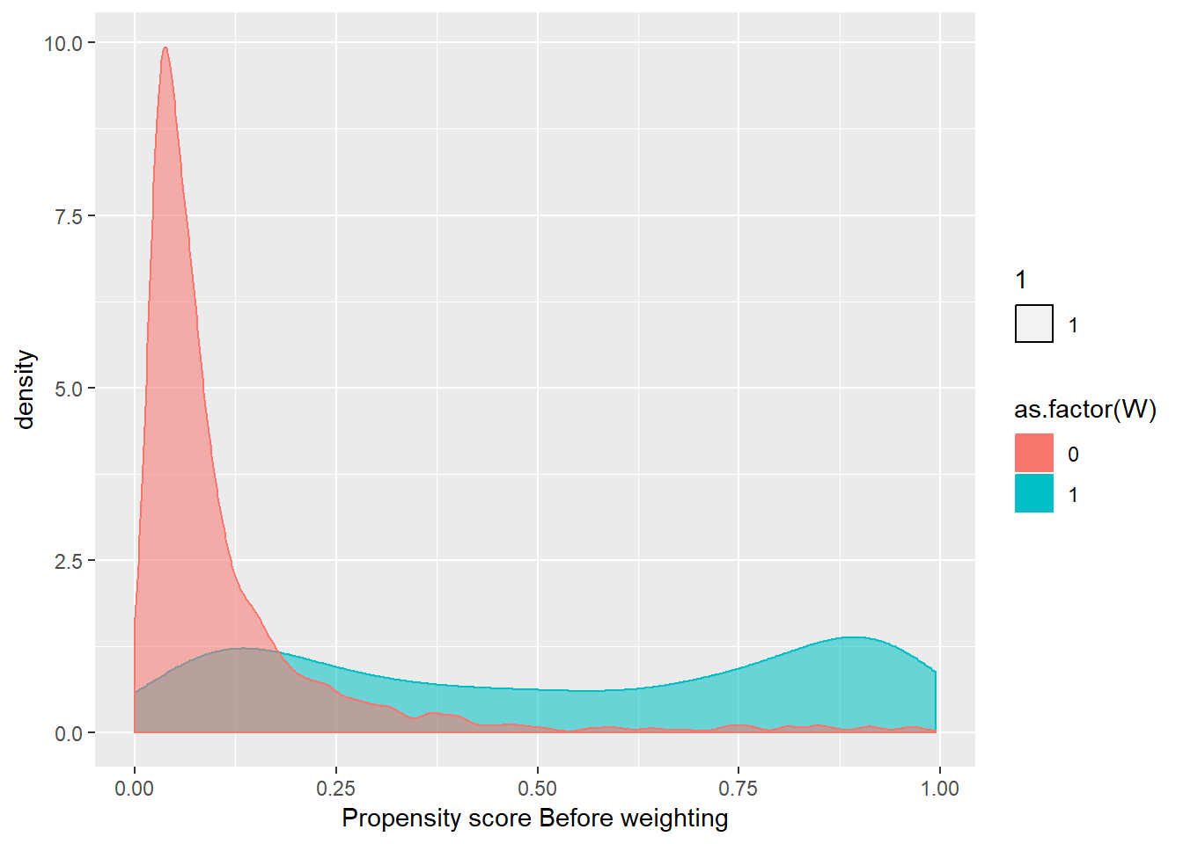
Causal Inference
Inverse Propensity Weighting
Notes:
Présenter Y et W
W indé de {Y(1), Y(0)}

Slide 39
Causal Inference
Inverse Propensity Weighting
IPW estimator :
e : Logistic regression Acide tranexamique ~ X (cofounder factors)
Computing the formula
Double-robust estimator
Weighted linear regression DC.Trauma ~ Treatment or not (slope)

Slide 40
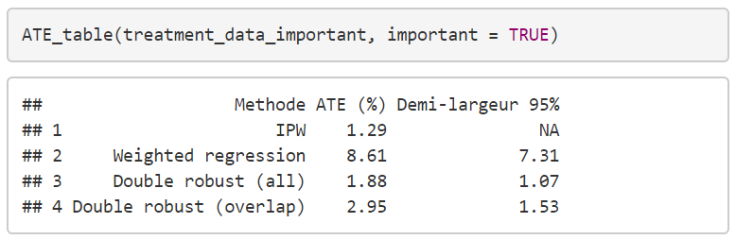
Causal Inference
Inverse Propensity Weighting

Slide 41
Causal Inference
Inverse Propensity Weighting
Random forest ?
Alcool ? DTC.IP.max ?
Glasgow.sortie ?
Notes:
We run
Not significantly different (0,1%)

Slide 42
Causal Inference
Inverse Propensity Weighting

Slide 43
Conclusion

